Slide 1
Introduction to Operating Systems
CPSC/ECE 3220 Spring 2020
Lecture Notes
OSPP Chapter 4 – Part A
(adapted by Mark Smotherman and Lana Drachova from Tom Anderson’s slides on OSPP web site)

Slide 2
Motivation for Threads
Operating systems (and application programs) often need to be able to handle multiple things happening at the same time
Process execution, interrupts, background tasks, system maintenance
Humans are not very good at keeping track of multiple things happening simultaneously
Concurrency – when multiple activities happen at the same time.

Slide 3
Examples of Concurrency
Servers
Multiple connections handled simultaneously
Parallel programs
To achieve better performance
Programs with user interfaces
To achieve user responsiveness while doing computation
Network and disk bound programs
To hide network/disk latency

Slide 4
Definitions
A thread is a single execution sequence that represents a separately schedulable task
Threads are an abstraction of sequential execution
Tasks run concurrently, but code for each task is sequential.
Single execution sequence: familiar programming model
Separately schedulable: OS can run or suspend a thread at any time
Threads are suspended and resumed transparently

Slide 5
Threads vs. Processes
For parallel processing involving shared objects, threads are more efficient than processes
Cheaper to create and destroy
Faster to switch among
Communicate through shared memory in single process
But code is hard to get correct when multiple threads can update shared objects

Slide 6
Threads vs. Processes
Process – execution of a program with restricted rights.
Thread – sequence of instructions running within a processn.
OSs are different:
One thread per process
Many threads per process
Many single-threaded processes
Many kernel threads

Slide 7
Thread Abstraction
An illusion of infinite number of processors
Threads execute with variable speed
Programs must be designed to work with any scheduler
Otherwise false assumptions can lead to incorrect results

Slide 8
Programmer vs. Processor View
Threads can be preempted (voluntarily or non-voluntarily)

Slide 9
Possible Executions
Threads may be interleaved at runtime

Slide 10
Thread Operations
thread_create(thread, func, args)
Create a new thread to run func(args) concurrently with the calling thread.
thread_yield()
Relinquish processor voluntarily, scheduler resumes running it when it choses to.
thread_join(thread)
In parent, wait thread to finish, then return. Call once per thread.
thread_exit(return_value)
Quit thread and clean up, store ret value in current thread’s DS. Resume waiting thread, if any.

Slide 11
Thread API and POSIX Thread API
POSIX – Portable Operating System Interface for Unix (defined in IEEE standard)
It is a language-independent execution model using pthreads (POSIX threads) with >100 procedures for
Thread creation/joning
Mutual exclusion
Condition variables
Synchronization
Most effective in multiprocessor or multicore systems
We will use a simplified API based on POSIX standards pthreads API, but omit some features for simplicity.

Slide 12
Thread Basics
Thread operations include thread creation, termination, scheduling, data management and process interaction.
A thread does not maintain a list of created threads, nor does it know the thread that created it.
Threads within a process share the same address space:
Process instructions
Most of the data
open files (descriptors)
interrupt handlers
Each thread has a unique:
Thread ID
set of registers, stack pointer
stack for local variables, return addresses
priority

Slide 13
Thread Context Switch
Voluntary
thread_yield() -
thread_join() – if child is not done yet
Involuntary (“preemption”)
Interrupt or exception
Some other thread is higher priority

Slide 14
Fork/Join Executes a Procedure Call in Parallel
Procedure Call/Return
call func()→ func()
execute
← return
execute
Single path of execution
Caller resumes execution on return
Thread Fork/Join
t_create()→ func()
execute execute
t_join() ← t_exit()
execute
Parallel execution
Exit is immediate
Join will wait for exit, if necessary

Slide 15
Example: threadHello
#include <stdio.h>
#include “thread.h”
#define NTHREADS 10
thread_t threads[NTHREADS];
main() {
for (i = 0; i < NTHREADS; i++) thread_create(&threads[i], &go, i);
for (i = 0; i < NTHREADS; i++) {
exitValue = thread_join(threads[i]);
printf("Thread %d returned with %ld\n", i, exitValue);
}
printf("Main thread done.\n");
}
void go (int n) {
printf("Hello from thread %d\n", n);
thread_exit(100 + n);
// Not reached, thread_exit is immediate
}

Slide 16
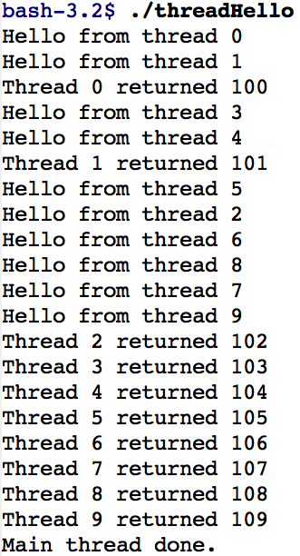
threadHello: Example Output
Why does “thread returned” print in order?
What is maximum # of threads running when thread 5 prints hello?
Minimum?

Slide 17
Fork/Join Concurrency
Threads can create children, and wait for their completion
Data can be shared before fork and after join
Otherwise extra code to coordinate access (Chapter 5)
Examples:
Web server: fork new thread for each new connection
As long as the threads are completely independent
Merge sort
Parallel memory copy

Slide 18
bzero with fork/join concurrency
void blockzero (unsigned char *p, int length) {
int i, j;
thread_t threads[NTHREADS];
struct bzeroparams params[NTHREADS];
// For simplicity, assumes length is divisible by NTHREADS.
for (i = 0, j = 0; i < NTHREADS; i++, j += length/NTHREADS) {
params[i].buffer = p + i * length/NTHREADS;
params[i].length = length/NTHREADS;
thread_create_p(&(threads[i]), &go, &params[i]);
}
for (i = 0; i < NTHREADS; i++) {
thread_join(threads[i]);
}
}

Slide 19
Thread Data Structures

Slide 20
Before thread_create()
Processes are
created with a
single thread
PCB
open files, …
text
TCB1
data
heap
memory
address
space
T1
stack 1

Slide 21
After thread_create()
One process
with two
threads
PCB
open files, …
text
TCB1
TCB2
data
the two
threads
share the
memory
address
space
heap
T1 and T2
stack 2
stack 1

Slide 22
Thread Metadata
Thread ID
Scheduling priority
Thread state (ready, running, waiting, …)
State of Thread | Location of TCB | Location of Registers
Init | being created | TCB or thread’s stack
Ready | Ready List | TCB/stack
Running | Running List | processor
Waiting | synch. variable’s Waiting List | TCB/stack
Finished | Finished List then deleted | TCB/stack or deleted

Slide 23
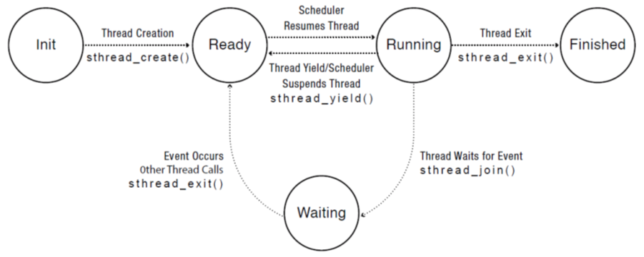
Thread Lifecycle

Slide 24
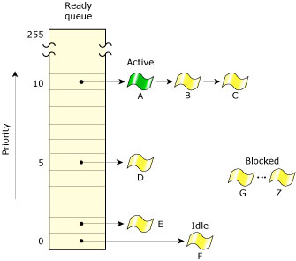
Ready Threads in QNX
Shows alternate design decisions with one list per priority level and with running thread (“active”) remaining linked
Diagram from http://www.qnx.com/developers/docs/6.3.2/neutrino/sys_arch/kernel.html

